Slide 1


CPU Design and Verification
: RISC-V CPU Design
발표자: 김지환

Slide 2
Contents
01.
Introduction
02.
Block Diagram
03.
Waveform by type
04.
Conclusion

Slide 3



01. Introduction
Notes:
RISC-V 설명,
설계한 하버드 구조 설명
구현한 rv32i IS 설명
개발 환경 설명

Slide 4




01. Introduction
VS
Notes:
RISC-V 설명,
설계한 하버드 구조 설명
구현한 rv32i IS 설명
개발 환경 설명

Slide 5



01. Introduction
Notes:
RISC-V 설명,
설계한 하버드 구조 설명
구현한 rv32i IS 설명
개발 환경 설명

Slide 6
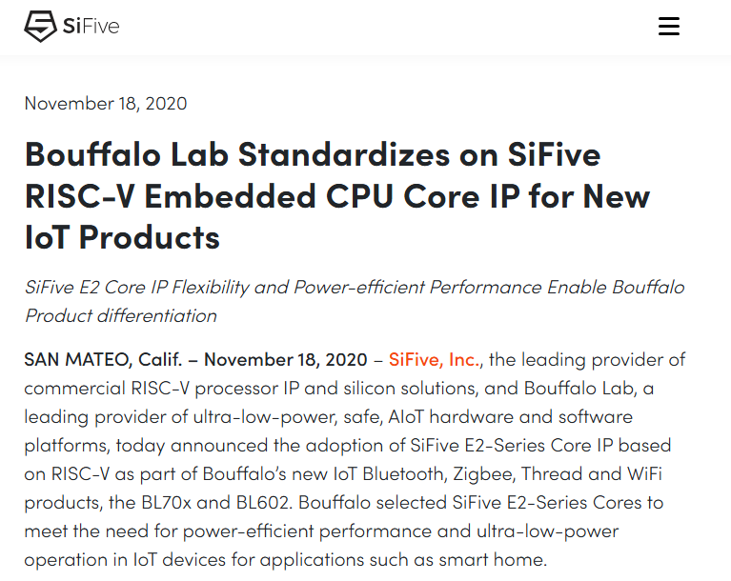
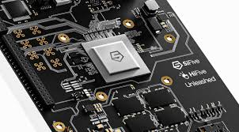
01. Introduction
Notes:
RISC-V 설명,
설계한 하버드 구조 설명
구현한 rv32i IS 설명
개발 환경 설명

Slide 7
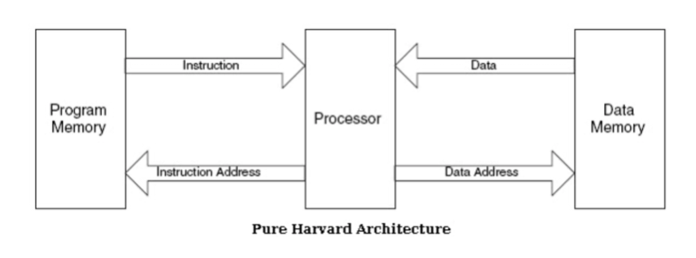
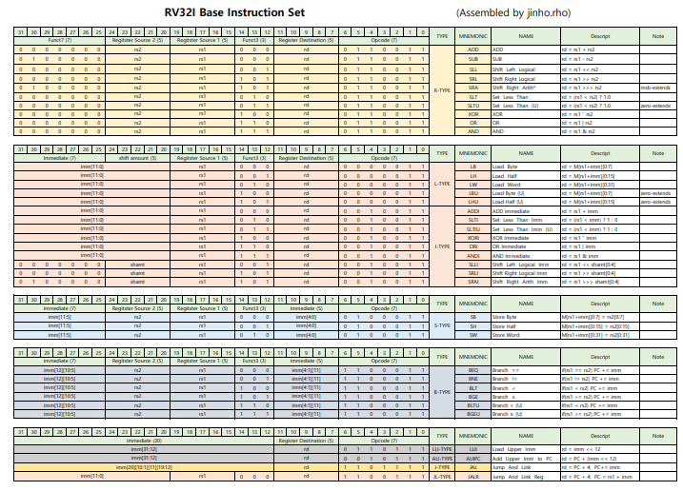
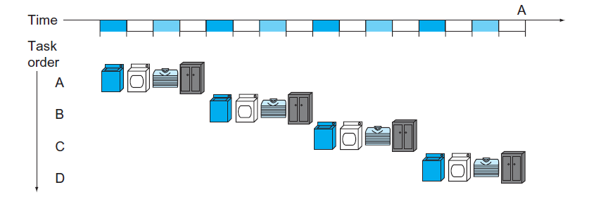
01. Introduction
Notes:
RISC-V 설명,
설계한 하버드 구조 설명
구현한 rv32i IS 설명
개발 환경 설명

Slide 8


01. Introduction
Notes:
RISC-V 설명,
설계한 하버드 구조 설명
구현한 rv32i IS 설명
개발 환경 설명

Slide 9
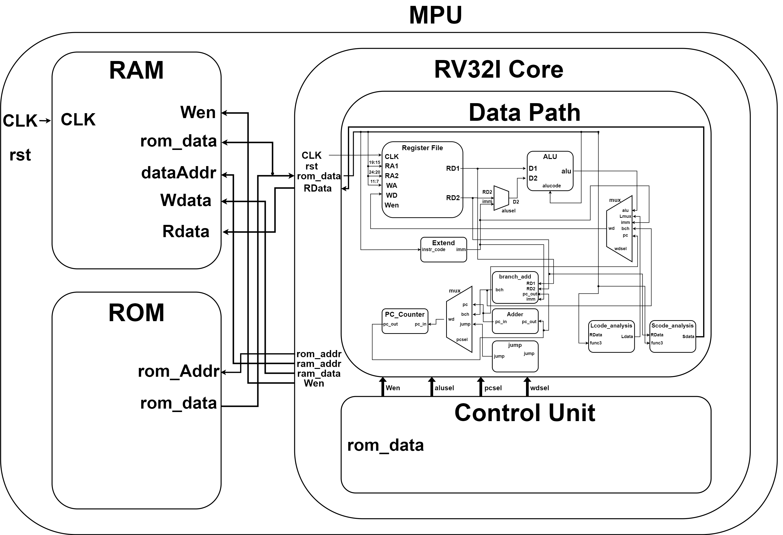
02. Block Diagram

Slide 10
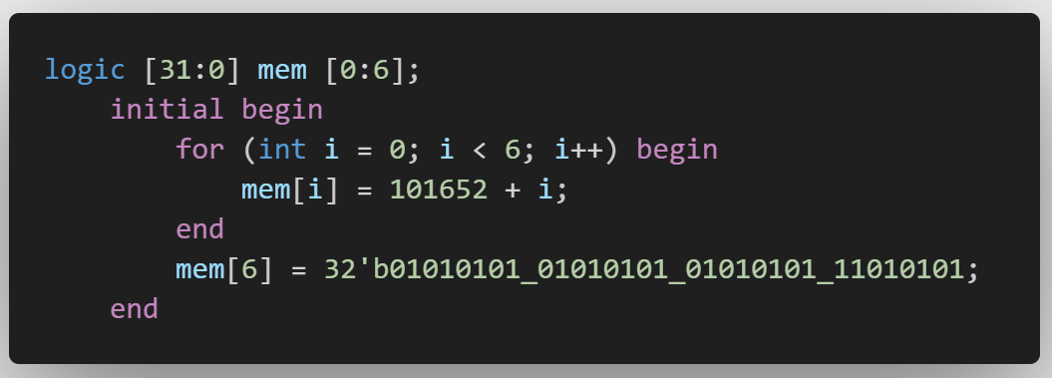
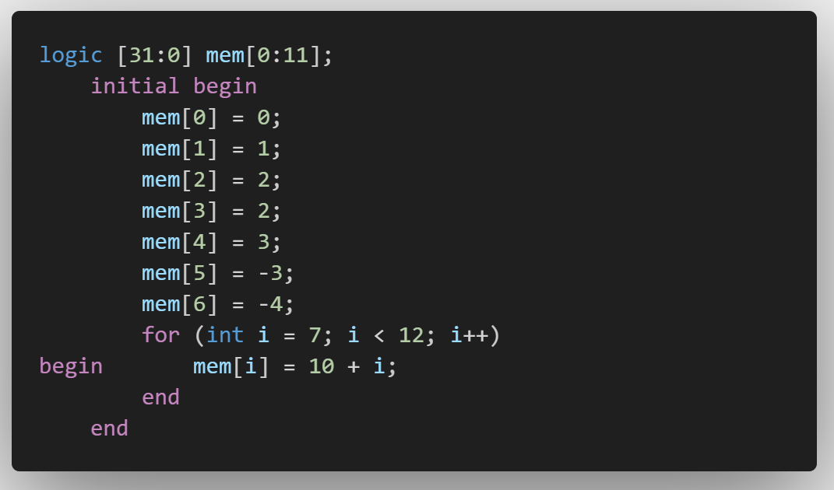
03. Waveform by type
Initial_Setting
Ram
RF

Slide 11
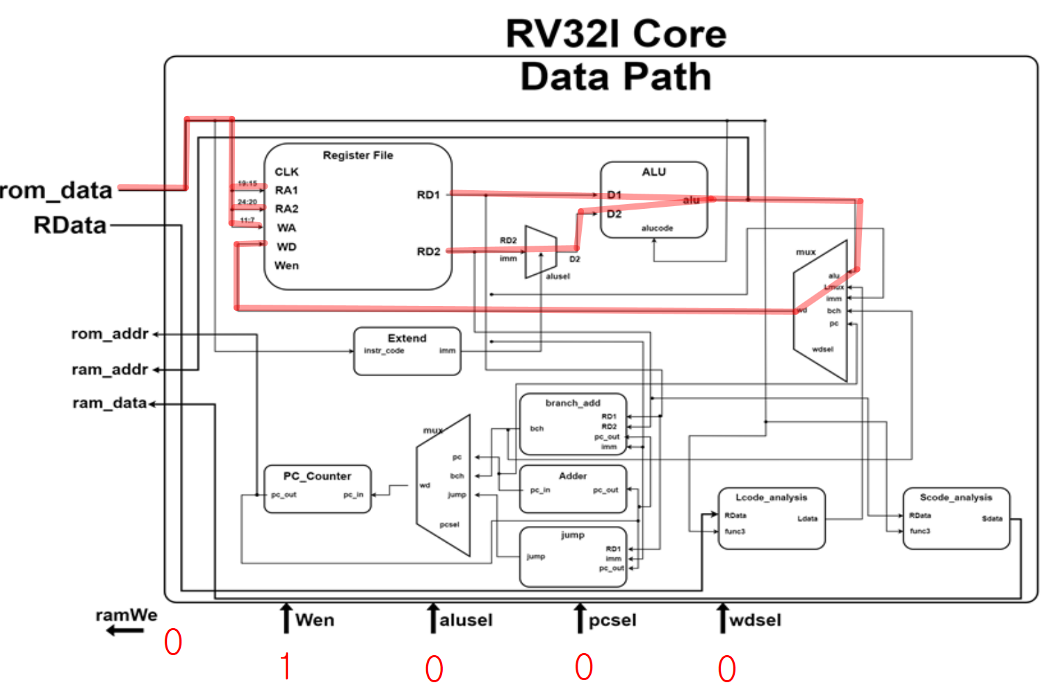
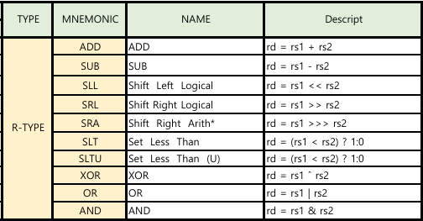
03. Waveform by type
R-Type
1. Rom_data -> RegFile RAddr
2. RegFile Rdata1, 2 -> ALU
3. ALU -> 5x1 wdMux
4. 5x1 wdMux -> RegFile WData

Slide 12
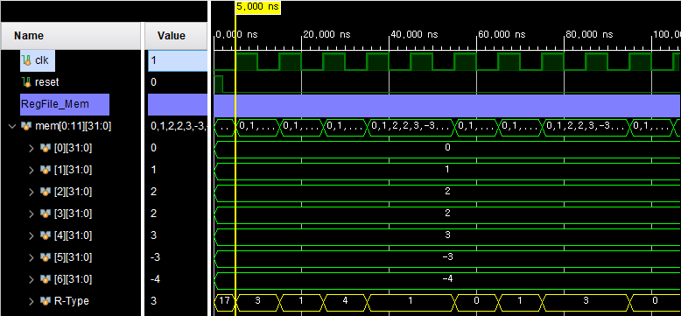
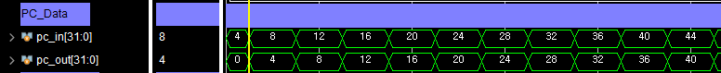
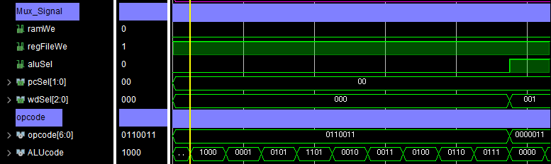
03. Waveform by type
R-Type

Slide 13
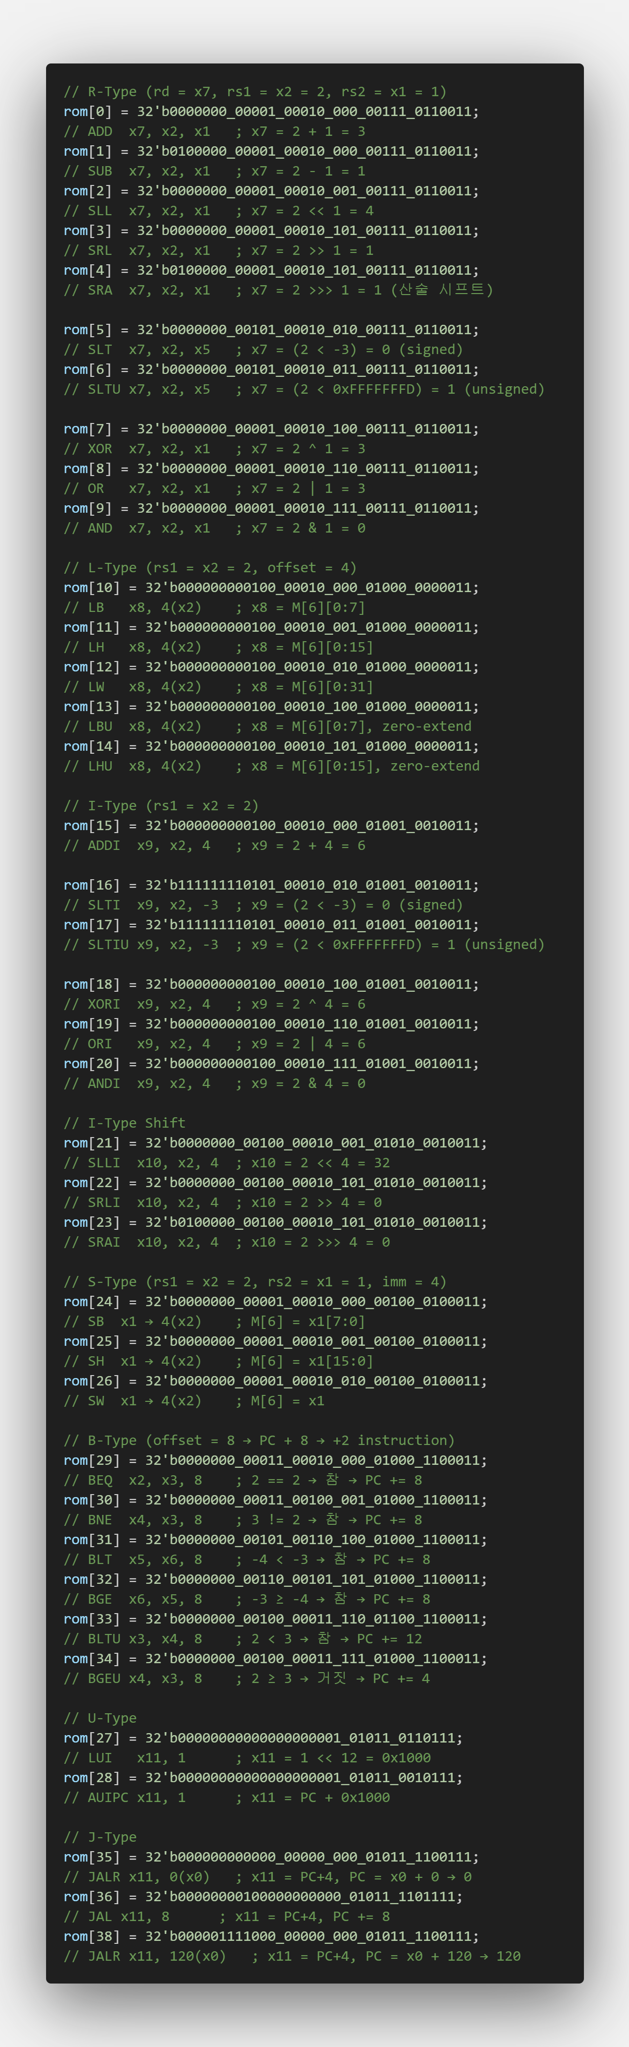
03. Waveform by type
R-Type

Slide 14
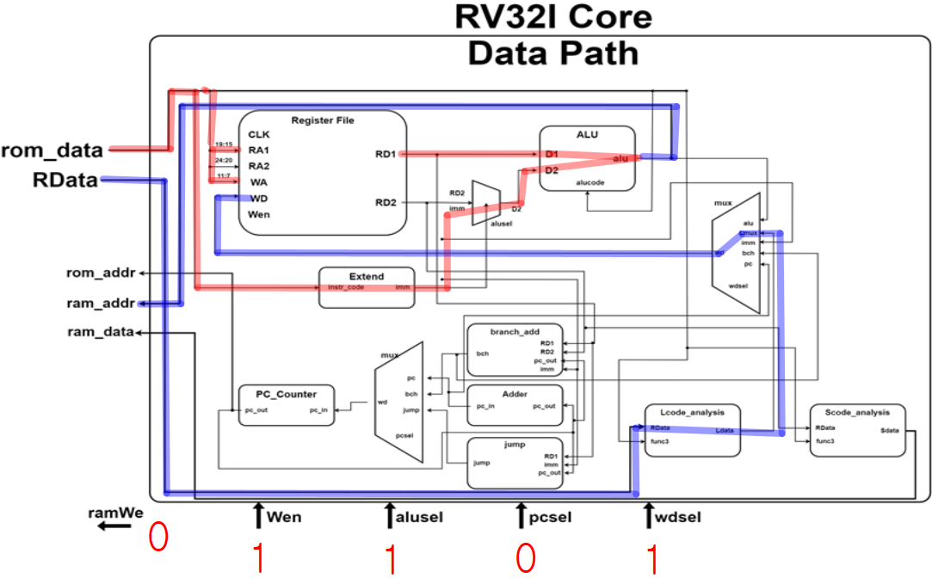
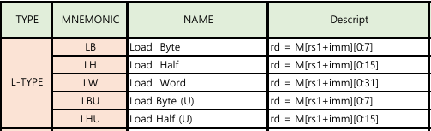
03. Waveform by type
L-Type
1. Rom_data -> RegFile RA1, WA
Rom_data -> imm_Extend
2. RegFile Rdata, imm -> ALU
3. ALU -> ram_Addr
4. ram_Rdata -> Lcode_analysis
5. Lcode_analysis -> 5x1 wdMux
6. 5x1 wdMux -> RegFile WData

Slide 15
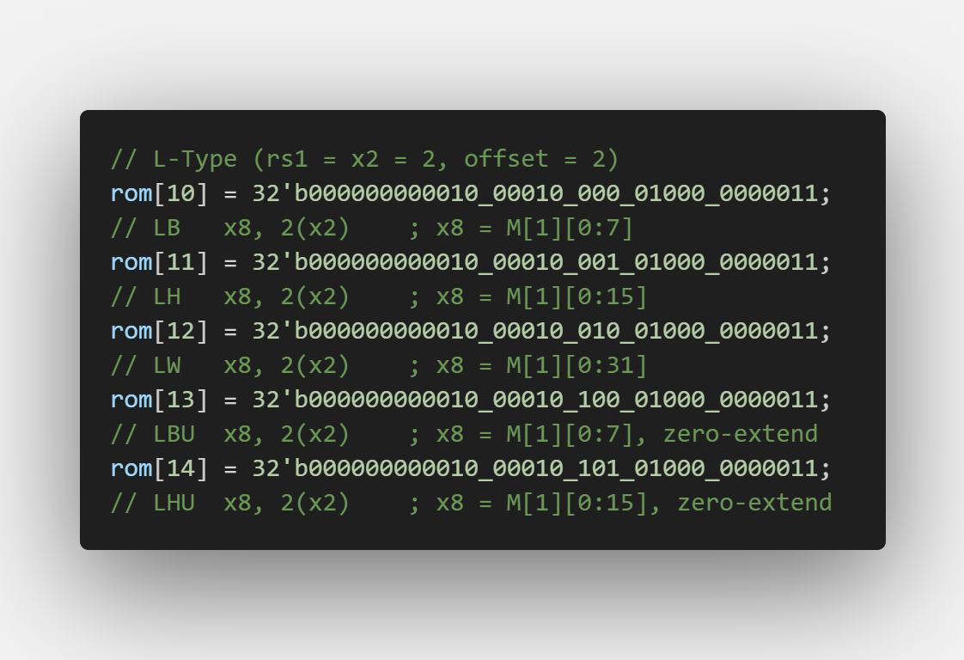
03. Waveform by type
L-Type

Slide 16
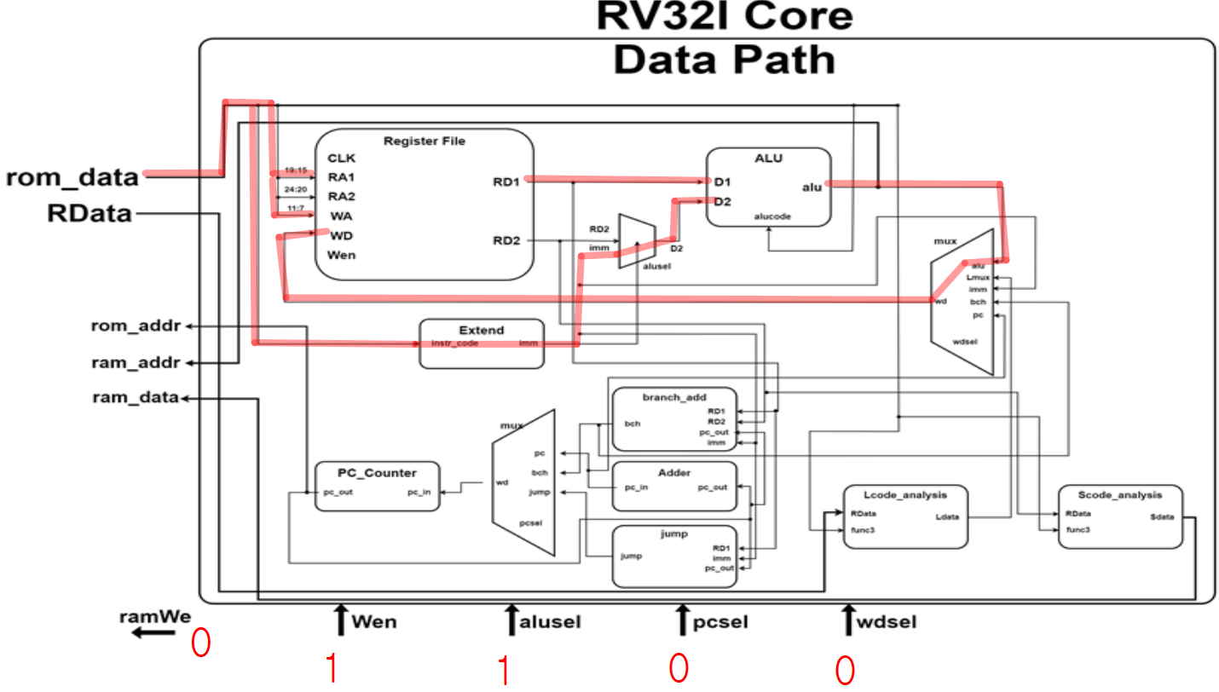
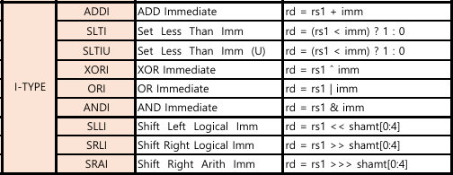
03. Waveform by type
I-Type
1. Rom_data -> RegFile RA1, WA
Rom_data -> imm_Extend
2. RegFile Rdata1, imm -> ALU
3. ALU -> 5x1 wdMux
4. 5x1 wdMux -> RegFile WData

Slide 17
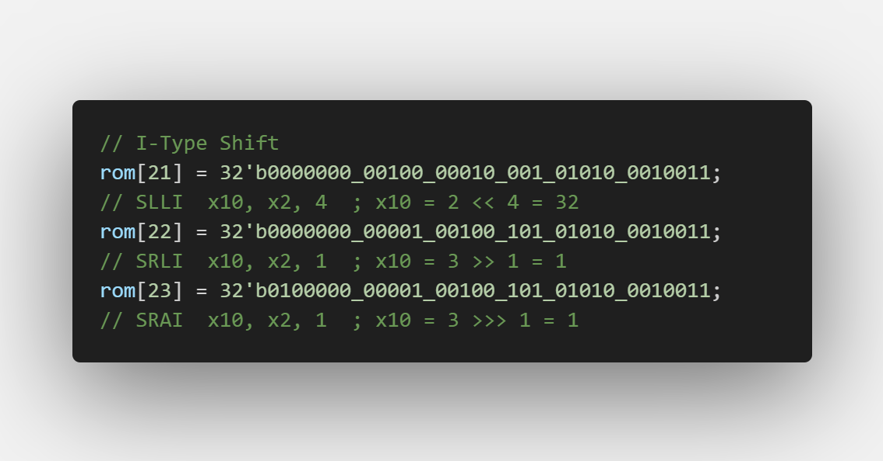
03. Waveform by type
I-Type

Slide 18
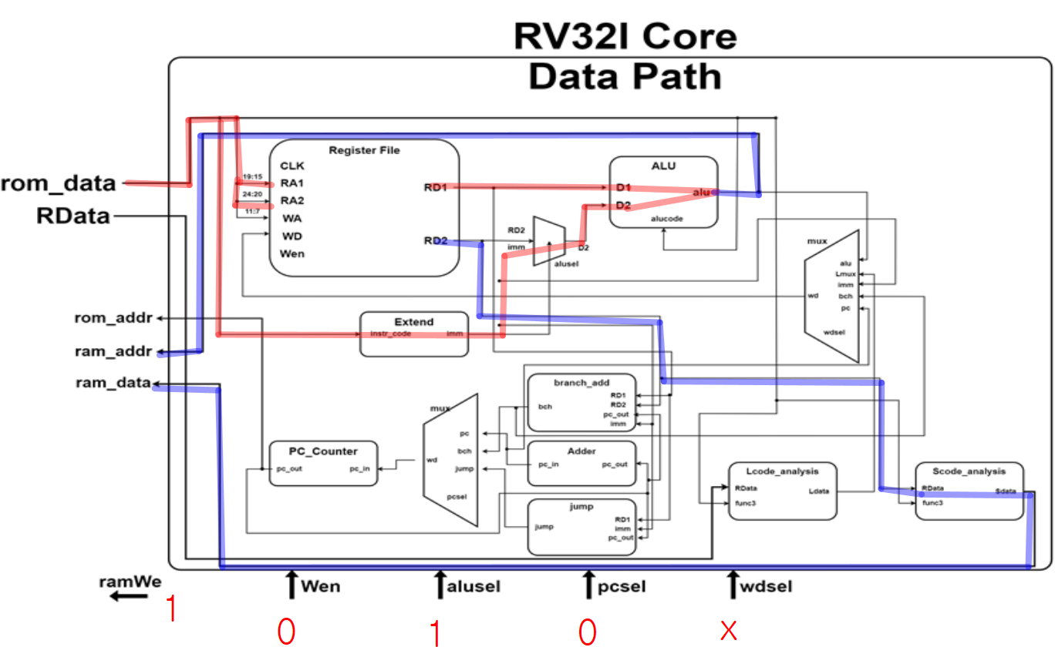
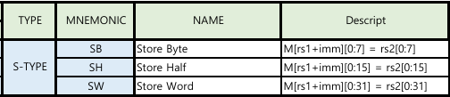
03. Waveform by type
S-Type
1. Rom_data -> RegFile RA1, 2
Rom_data -> imm_Extend
2. RegFile RD1, imm -> ALU
RD2 -> Scode_analysis
3. ALU -> ram_Addr
Scode_analysis -> ram_data

Slide 19
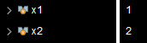
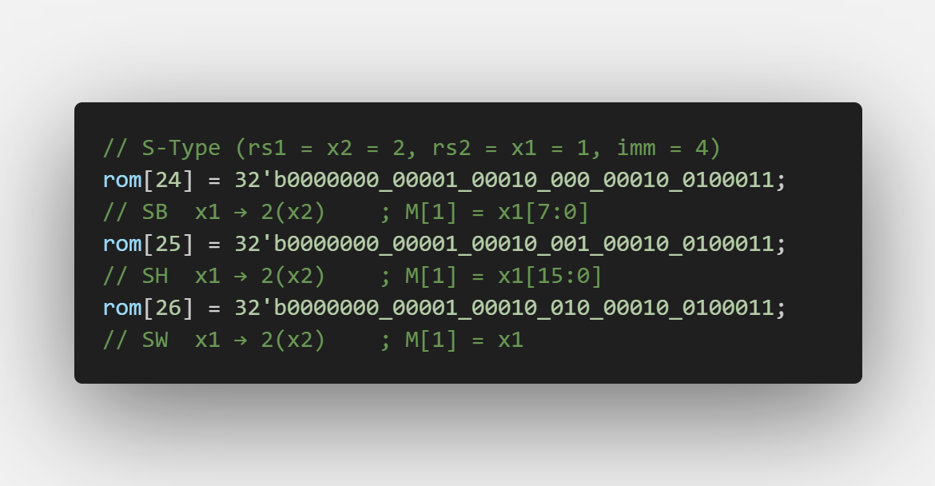
03. Waveform by type
S-Type

Slide 20
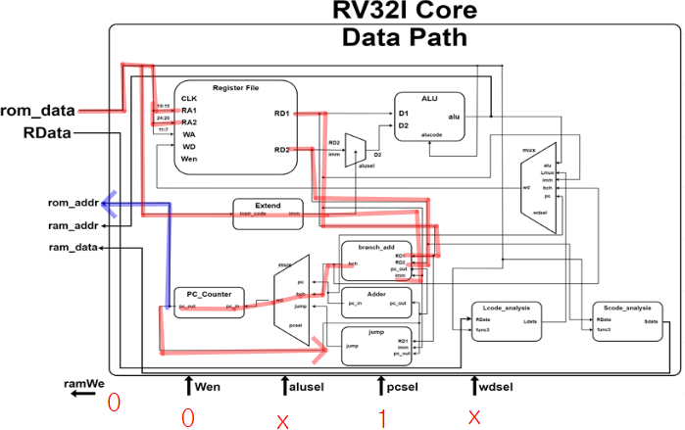
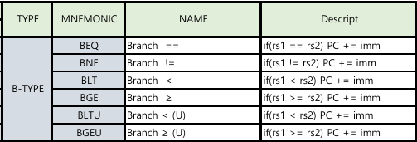
03. Waveform by type
B-Type
1. Rom_data -> RegFile RA1, 2
Rom_data -> imm_Extend
2. RD1, 2, imm -> branch
3. branch -> 3x1 pcMux
4. 3x1 pcMux -> PC_counter
5. PC_counter -> rom_addr
PC_counter Loop back

Slide 21
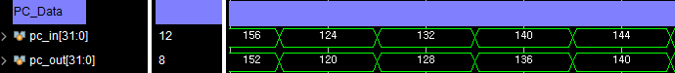
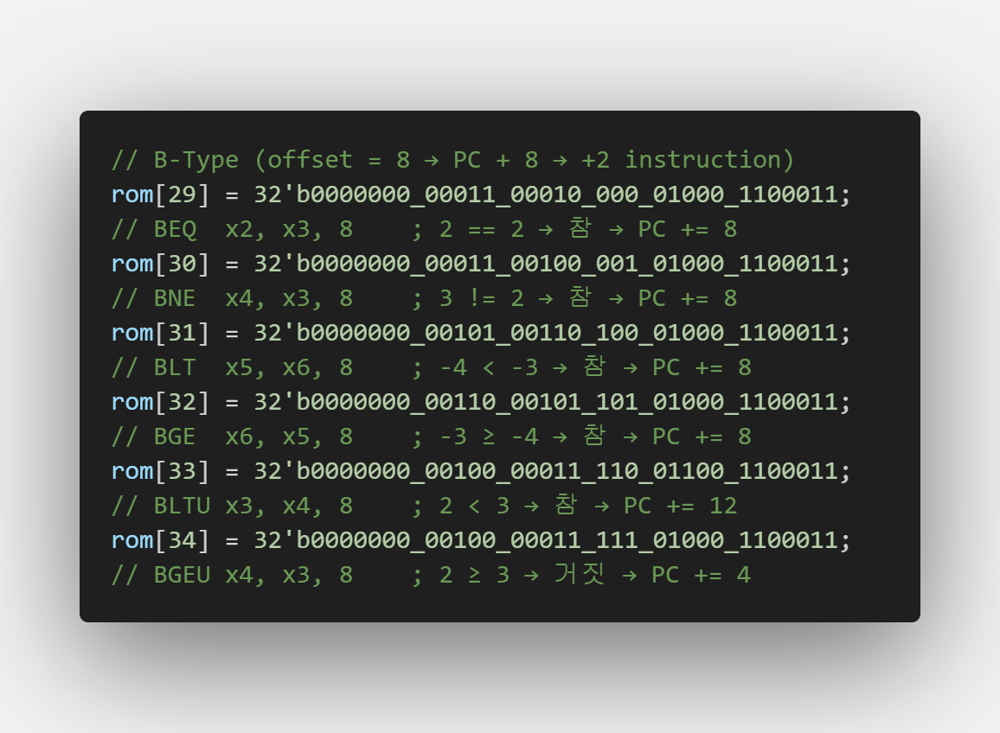
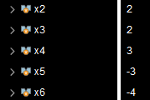
03. Waveform by type
B-Type

Slide 22
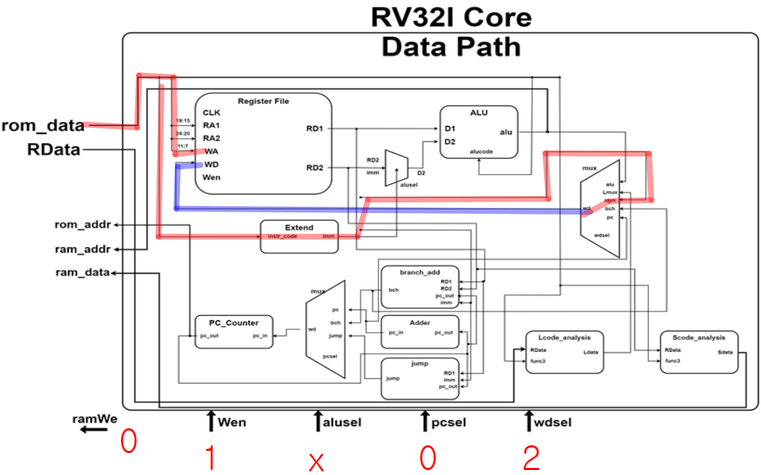
03. Waveform by type
LU-Type
1. Rom_data -> RegFile WA
Rom_data -> imm_Extend
2. imm -> 5x1 wdMux
3. 5x1 wdMux -> RegFile WD

Slide 23
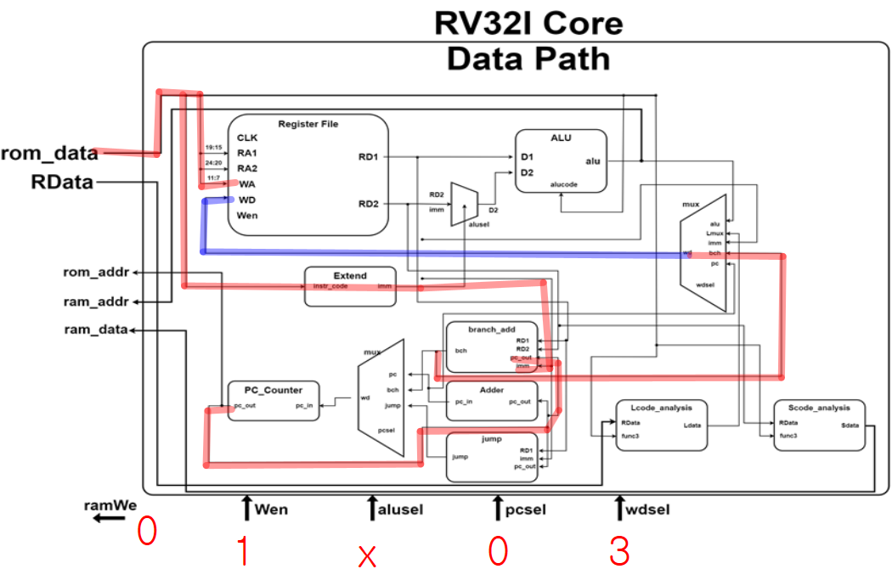
03. Waveform by type
AU-Type
1. Rom_data -> RegFile WA
Rom_data -> imm_Extend
2. imm -> Add
PC_counter -> Add
3. Add -> 5x1 wdMux
4. 5x1 wdMux -> RegFile WD

Slide 24
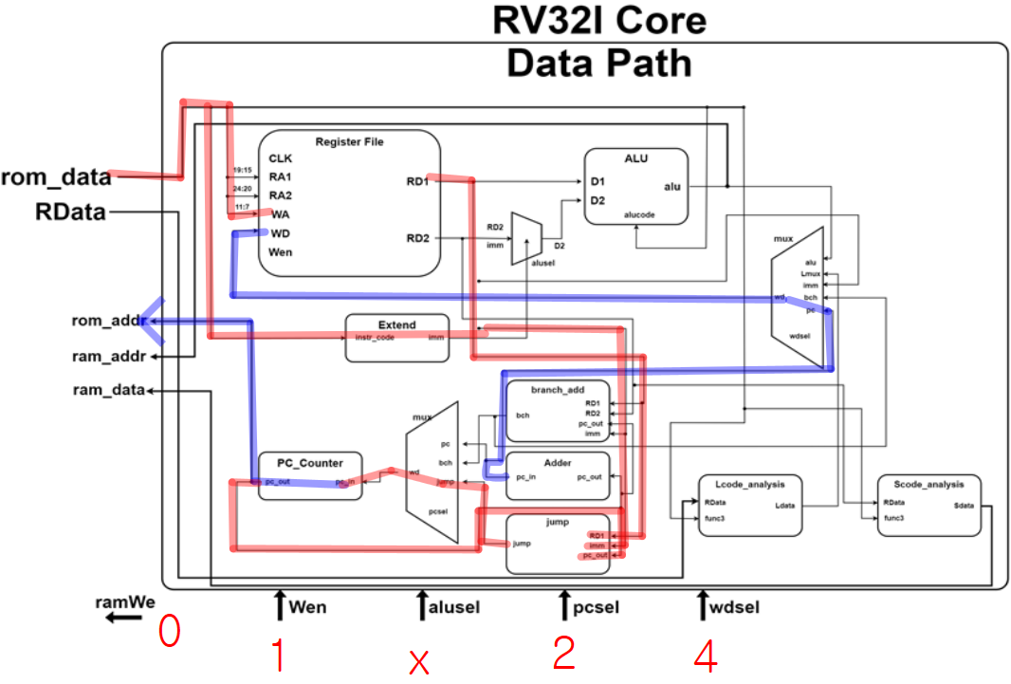
03. Waveform by type
J, JL-Type
1. Rom_data -> RegFile WA
Rom_data -> imm_Extend
2. imm -> jump
PC_counter -> jump
RD1 -> jump
3. Adder -> 5x1 wdMux
jump -> 3x1 pcMux
4. 5x1 wdMux -> RegFile WD
3x1 pcMux -> PC_counter
5. PC_counter -> rom_addr
J : pc + imm -> jump
JL : RD1 + imm -> jump

Slide 25
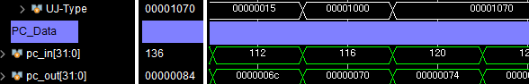
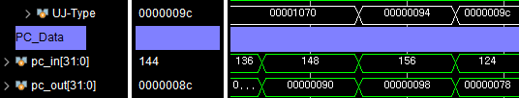
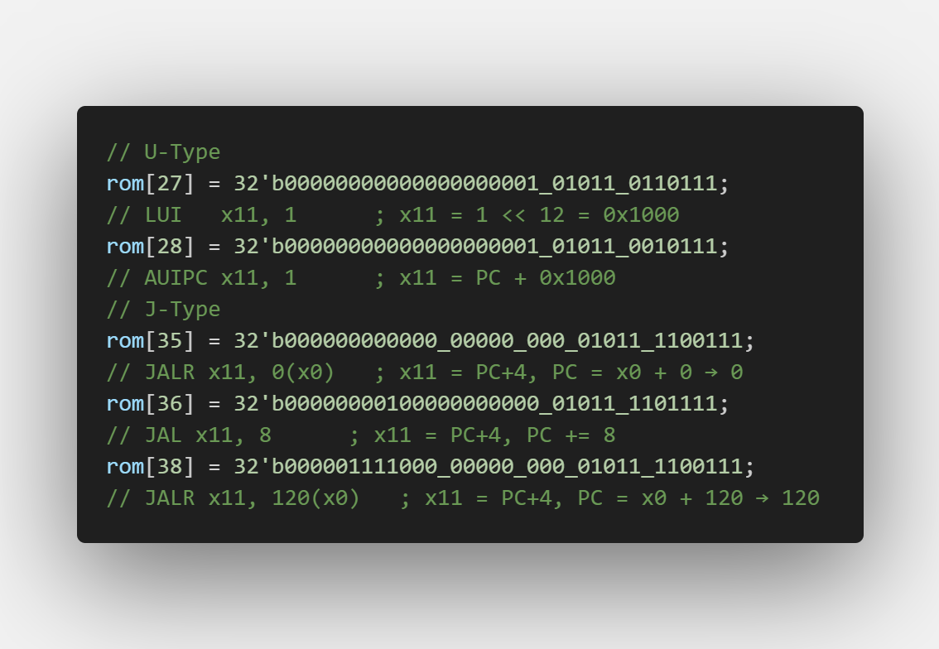
03. Waveform by type
U, J-Type

Slide 26
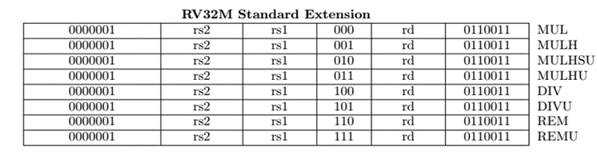
04. Conclusion
=> RV32IM Core
Notes:
향후 개선 방향(예: 인터페이스 개선, 추가 기능 확장)

Slide 27
Thank you

